Slide 1
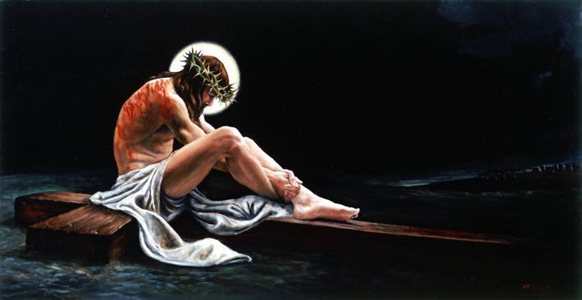
The Shadows of Good Friday
Christian Unity in John 17:20-26
Dr. Rick Griffith • Crossroads International Church • BibleStudyDownloads.org

Slide 2
One day left…
Notes:
If you had but one day left to live, what would you do?
I bet most of us would want to be with the people who matter the most to us—our family. Then I think we would tell them the things that matter the most to us —that we love them and what our aspirations are for their future after we're gone.

Slide 3
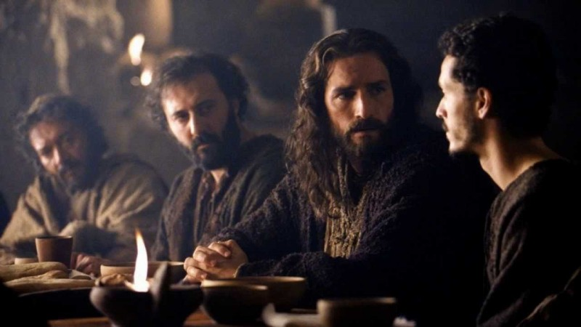
The "Family" of Jesus…
Notes:
Jesus was fully human, so he was not too far off from this depiction. Knowing he had less than a day to live, he sought to be with his "family" of disciples.

Slide 4
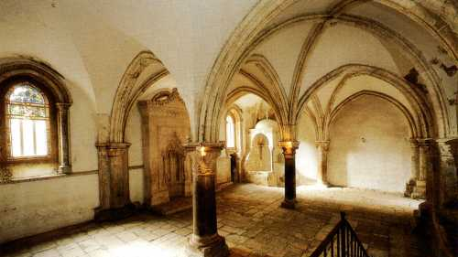
"An Upper Room"
Notes:
In an "upper room," he then poured into them the most valuable teaching he could.

Slide 5
Overview of John's Gospel
107
Deity Made Man for Eternal Life
Deity of the Son of God | Revelation of the Son of God |  | Preparation of the Son's Disciples | Passion & Resurrection of the Son of God | Adequacy of the Son of God
1:1-18 | 1:19–12:50 |  | 13–17 | 18–20 | 21
Prologue | Public |  | Private | Public | Private
Incarnation | 2 Signs Received 1:19–4:54 | 5 Signs Rejected 5–12 | Upper Room Discourse (no signs) | Ultimate Sign | Last Sign
Eternity Past | Fall AD 29- Monday, 30 March 33 |  | Thursday, 2 April 33 | Friday, 3 April 33- Sunday, 5 April 33 | May, AD 33
Ephesus (AD 65-69)
Notes:
We call it the "Upper Room Discourse" and we find this in John 13–17 at the heart of John's gospel.

Slide 6
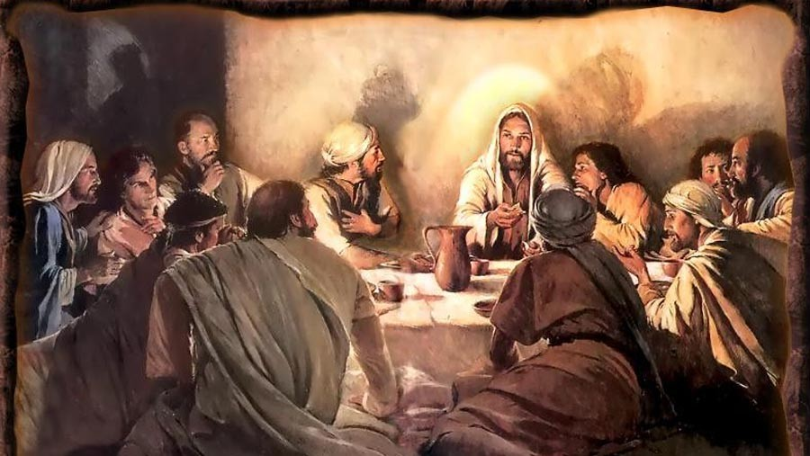
The Upper Room Discourse (John 13–17)
Notes:
This is Jesus' longest sermon in the gospels. He tells them be connected to him while hated by the world (13:1–16:4), be encouraged by another Comforter coming after Jesus in the person of the Holy Spirit (16:5-16), and be peaceful since their grief will turn to joy (16:17-33). Finally he prays for them (John 17).

Slide 7
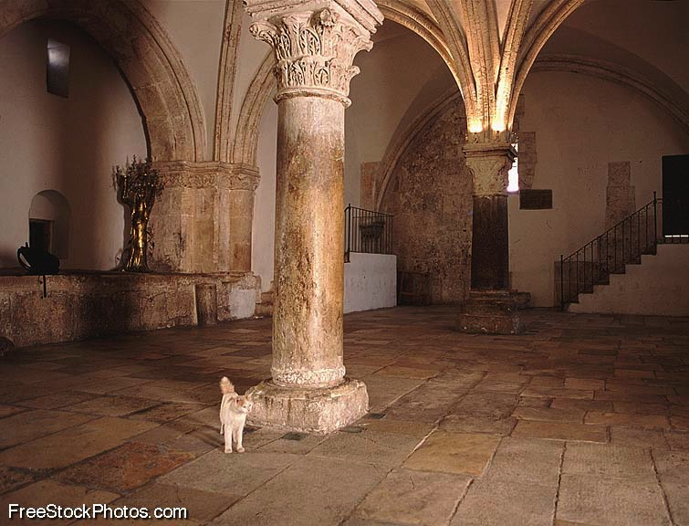
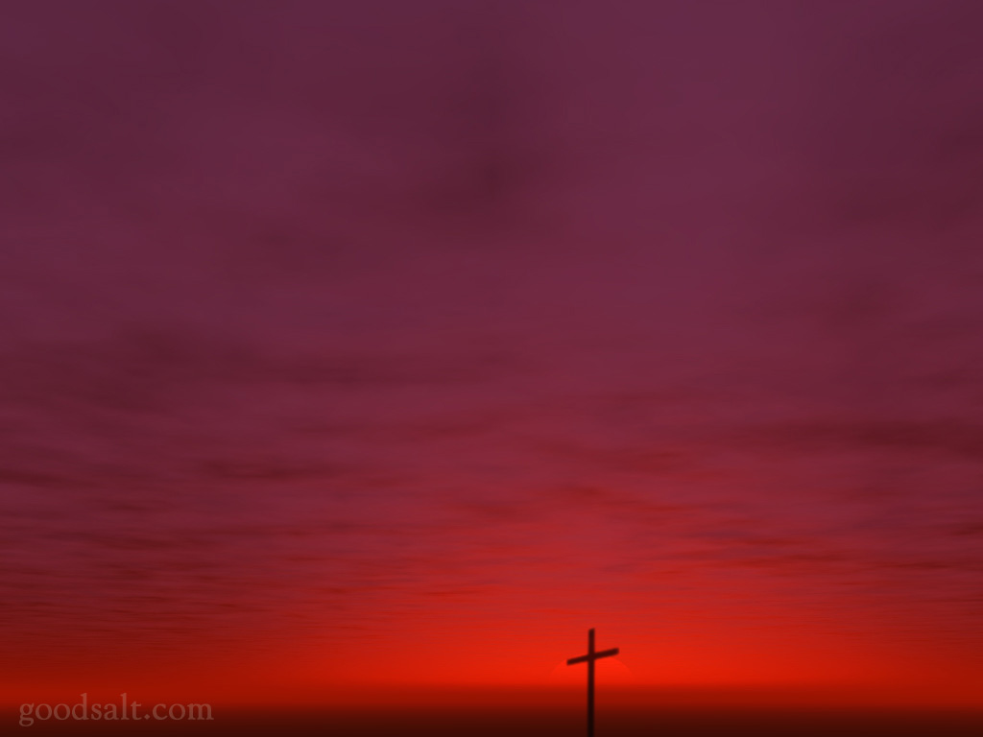
Christ's Prayer in John 17
"There is no voice which has ever been heard, either in heaven or in earth, more exalted, more holy, more fruitful, more sublime, than the prayer offered up by the Son to God Himself."
––Philip Melanchthon
Notes:
The Discourse ends with Jesus' longest prayer in the gospels. Melanchthon says…

Slide 8
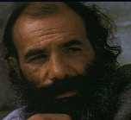
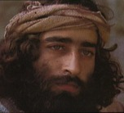
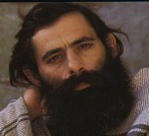
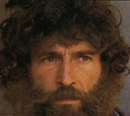
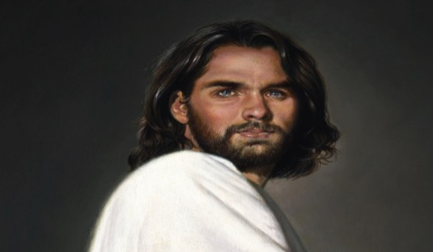
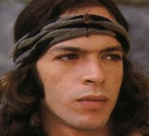
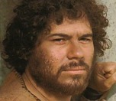
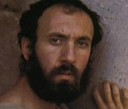
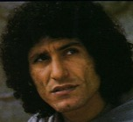
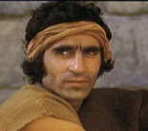
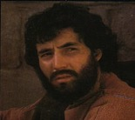
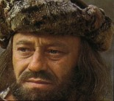
Widening Circle of Christ's Prayer
James
Thaddeus
John
Peter
For Himself
Andrew
Bartholomew
James bar Alphaeus
For Disciples
Thomas
Simon the Zealot
Philip
Matthew
For All Believers
Notes:
Here Jesus prays a threefold prayer for Himself, His disciples, and for all believers.
• In verses 1-5 Christ prays for Himself that God would glorify Him in His completion of His mission through His vicarious death.
• In verses 6-19 Christ prays that His disciples might have God's protection and sanctification while they remain in the world.
• Today's text in verses 20-26 concerns the last section of Christ's prayer that relates to us as a part of all believers.

Slide 9
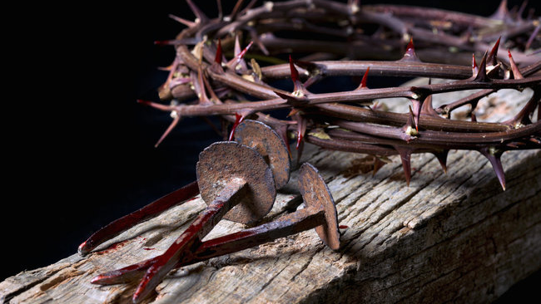
What was most important to Jesus as he anticipated the cross?
Notes:
What was most important to Jesus as he anticipated the cross?

Slide 10
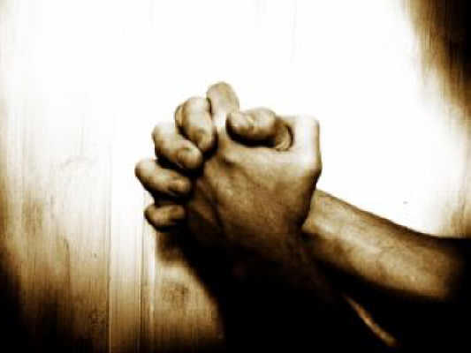
Jesus prayed for our unity (John 17)
Notes:
Today we will focus on the end of his prayer where he prays for our unity.

Slide 11
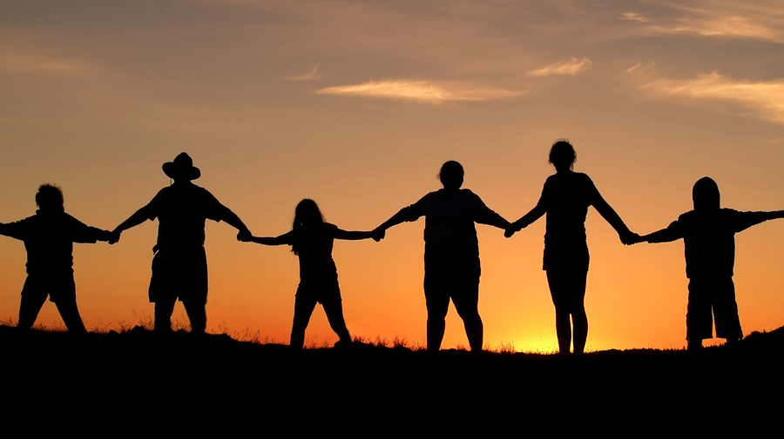
What is Unity?
Notes:
But what does unity look like?

Slide 12
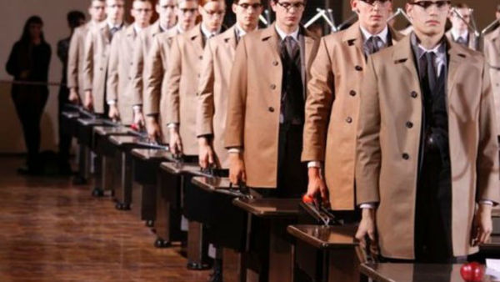
Uniformity
Notes:
Well, unity is not the same as uniformity. Many of us have worn uniforms at work, in the military, on sports teams, or some other team.
We are too painfully aware that just looking the same doesn't mean unity!

Slide 13
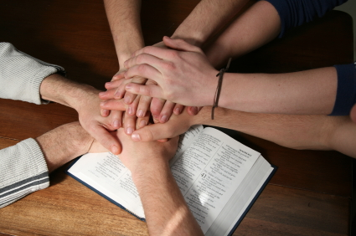
Why Unity?
Three reasons for unity…
Notes:
But why is unity so important that Christ would make it His final prayer for the saints? (Subject).
Today we will see three reasons Jesus gives for us to be united.
Verses 20-23 tell us that first motivation for unity is because…

Slide 14
I. Unity grows the church (20-23).
Unity
Notes:
When believers get along with one another, the church increases.

Slide 15
"My prayer is not for them alone. I pray also for those who will believe in me through their message" (17:20 NIV)

Slide 16
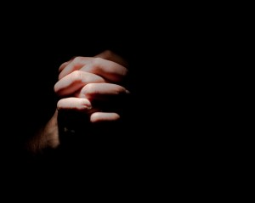
"that all of them may be one, Father, just as you are in me and I am in you" (17:21a NIV)

Slide 17
The Trinity
= Three-unity
Father
is
is not
is not
GOD
is
is
Son
Spirit
is not
H. Wayne House, Charts of Christian Theology and Doctrine, p. 45
Notes:
Our model for unity is the first and second members of the Trinity (20-21a).
Can you imagine the Father and the Son arguing over roles and responsibilities?
"Hey Father! I don't like this idea of dying on a cross. Count me out. If you think it's necessary, then you do it yourself!"
The Father replies, "No way!" and the Spirit agrees, adding, "And what this stuff about me having to give everyone gifts? What a hassle! I hate shopping!"
• In fact, "Trinity" really means "three-unity." Three persons of the Godhead have differing roles but work together in complete unity.

Slide 18
"that all of them may be one, Father, just as you are in me and I am in you. May they also be in us so that the world may believe that you have sent me. ²²I have given them the glory that you gave me, that they may be one as we are one: ²³I in them and you in me. May they be brought to complete unity to let the world know that you sent me and have loved them even as you have loved me" (21b-23 NIV).
Notes:
Likewise, our unity shows the world that Christ is from God (21b-23).
In my NIV text verses 20-23 comprise 5 sentences, which makes it hard to tell where the emphasis is in this section. But actually, the Greek text has only 2 sentences—verses 20-21 and verses 22-23, both of which have as their final idea "that the world may believe" and "to let the world know." The result of unity is evangelism!

Slide 19
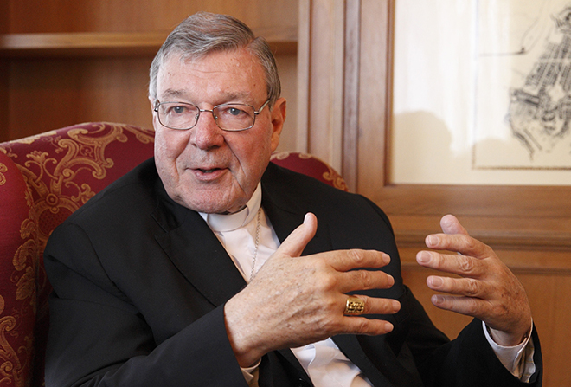
Interview of a Catholic Leader
Notes:
Some years back [1993], a British reporter asked a Catholic leader on the growth of evangelicals in the UK, "Are you concerned about this incredible growth among the evangelicals?" "No," came the firm reply. "Why not?" the reporter pressed. "I'm not concerned that the evangelicals have growth to 17 million here," the Catholic leader said. "I won't be concerned—that is, unless they decide to unite."

Slide 20
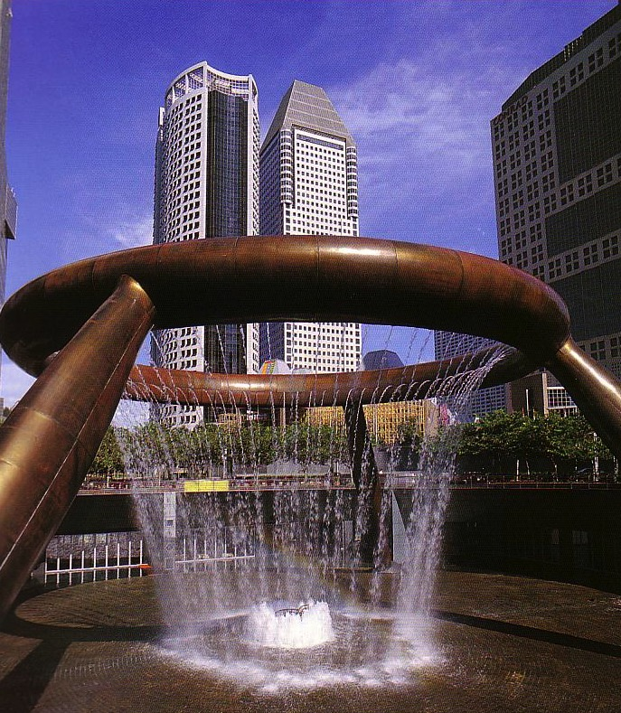
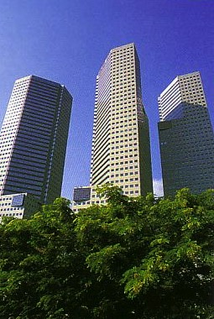
The City-State of Singapore
Notes:
In contrast, where there is unity, the world believes—like verses 21b and 23b say.
I think one reason the church in Singapore has grown in recent years is because it has learned something about unity despite race and language groups. Of the 4 major language groups in Singapore, 3 have been effectively reached: English, Mandarin, and Tamil.

Slide 21
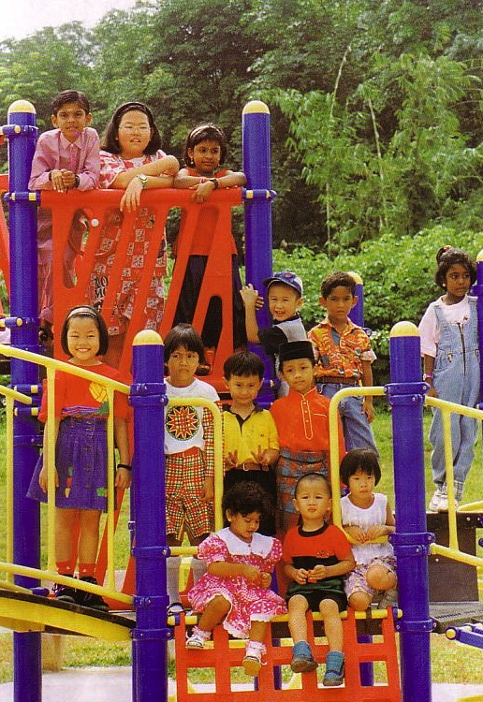
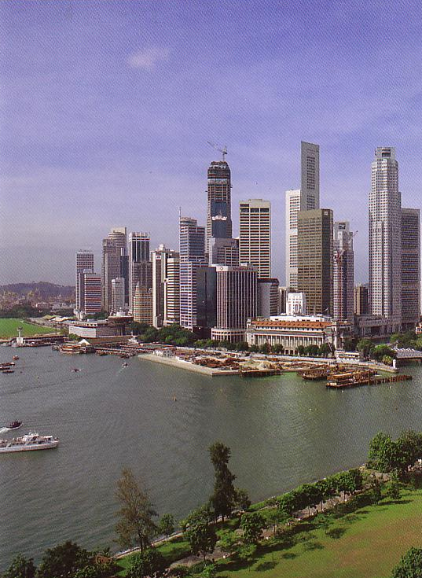
Multi-cultural • Multi-ethnic • Multi-religious
99% of Hindus are Indian
99% of Buddhists are Chinese
99% of Muslims are Malay
Only Christians effectively cross racial lines though Malays are still unreached
Notes:
• Did you know that 99% of Hindus are Indian
• 99% of Buddhists here are Chinese, and
• 99% of Muslims are Malay?
• In contrast, only Christians have reached across ethnic lines with 79% Chinese, 8% Indian, a half percent Malay, and 13% other groups.
Sure, we have a way to go, but I can't help but think that non-Christians have taken a more serious look at Christianity given the unity amidst diversity across racial and language lines.

Slide 22
Unity
Three reasons for unity
Notes:
I said Christ addresses three reasons for unity in today's text.

Slide 23
I. Unity grows the church (20-23).
Unity

Slide 24
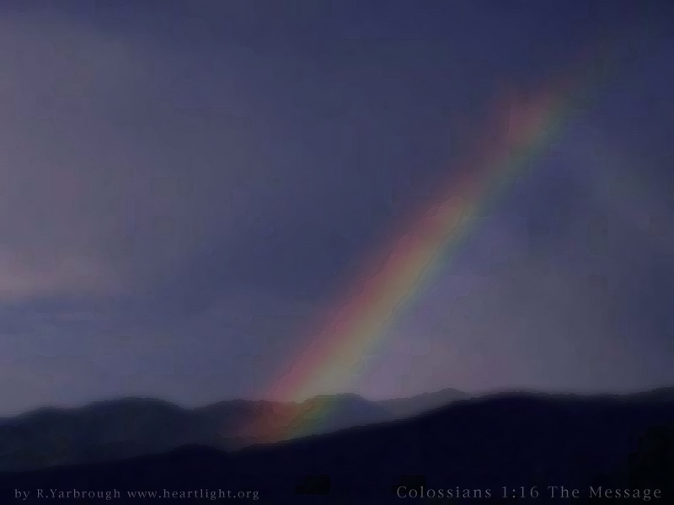
II. We'll be united in heaven forever —so let's start agreeing now (24).
Notes:
We'll be in glory together—so let's show some of that glory now.

Slide 25
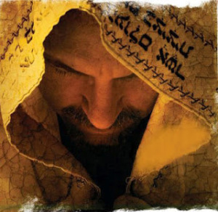
"Father, I want those you have given me to be with me where I am, and to see my glory, the glory you have given me because you loved me before the creation of the world" (17:24 NIV).
Notes:
Christ prayed that true Christians would "be with me where I am." What does He mean? He was right there, wasn't He? And weren't the disciples already there? Of course.
Here we see Jesus using the present tense to refer to something actually future. He does the same thing in verse 11 which literally reads, "I am in the world no longer," even though He was still there.
Christ is looking to the future with such certainty that He speaks of it in the present. The disciples hadn't seen His glory yet, in that He was confined to a human body. But they would see it—they'd all see it together.

Slide 26
Finding Directions in Heaven?
Notes:
I think the implication here is that since we'll be united forever in heaven, this should show down here as well.
Can you imagine in heaven trying to find your way around: "Let's see, here we are in the Presbyterian precinct. But where's Assemblies Avenue? Oh, OK, I see it here on the map—after Baptist Boulevard, Lutheran Lane, Reformed Road, Charismatic Crescent, and on the tip of Pentecostal Point!"
No way! We're all one family there. We'll keep our same race—you'll still be Chinese—but we won't be separated by a denominational distinctive!

Slide 27
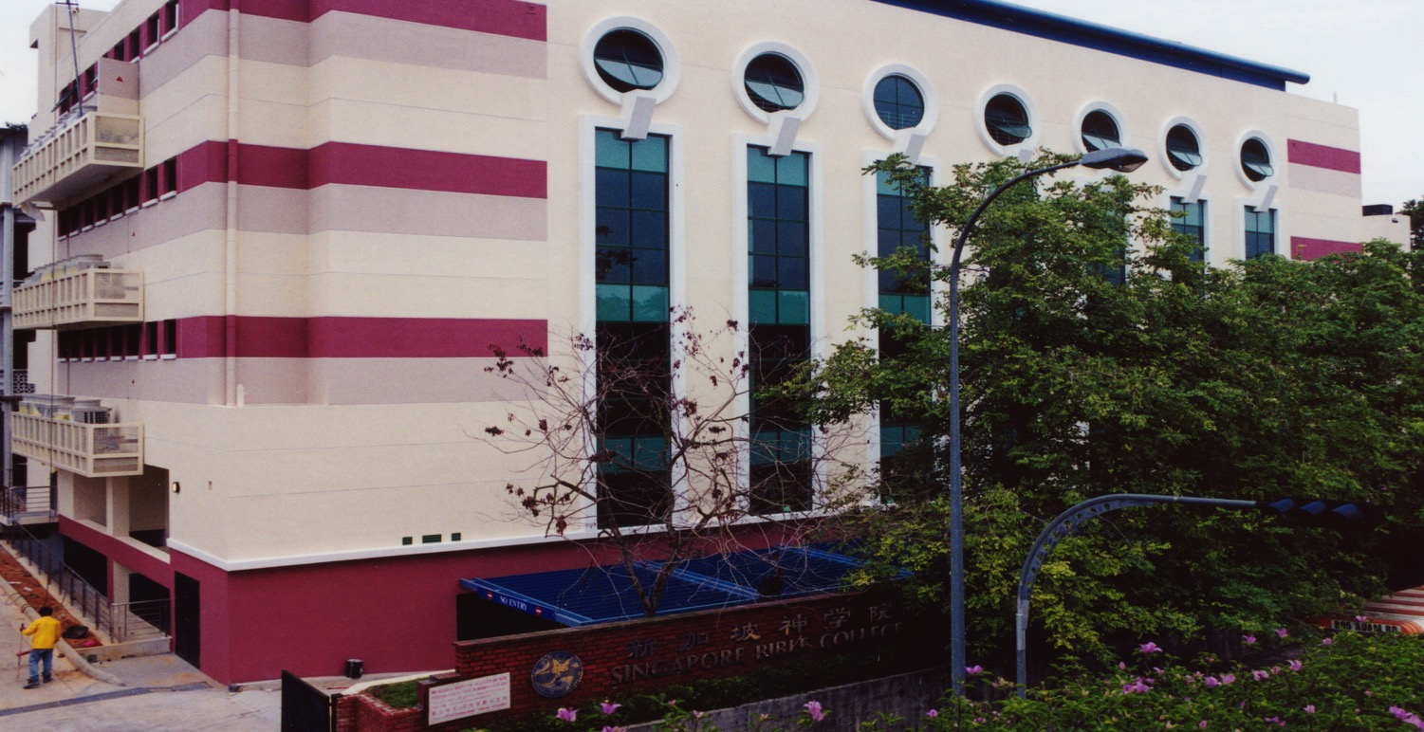
SINGAPORE BIBLE COLLEGE
Notes:
One of the best tastes of earthly unity before heavenly bliss is Singapore Bible College. Once I was teaching at SBC on the Book of Job. As I shared how different cultures explained the reasons for suffering, I asked a Pakistani student to share how Pakistani Muslims explain pain, then I asked an Indian student, "How do Indians view suffering?"

Slide 28
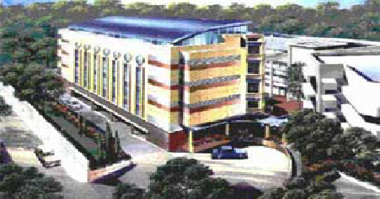
SBC Schools
Chinese
Music
Counseling
English
Established 1952
31 Full-time Faculty
500 Students
25 Denominations
25 Countries
29 Languages
Notes:
It suddenly occurred to me that our class not only had students from Pakistan and India, but also from Malaysia, Philippines, Myanmar, Korea, Indonesia, Hong Kong, and Singapore—in one class! SBC has 500 students from 25 nations and 20 denominations and functions as a genuinely diverse but equally genuinely united fellowship.

Slide 29
Church Unity
When should we not work together?
Notes:
But I should give one word of caution.
Genuine spiritual unity is possible only with genuine believers.

Slide 30
What does 2 Cor. 6:14-7:1 mean?
"
136
"Don't team up with those who are unbelievers. How can righteousness be a partner with wickedness? How can light live with darkness? ¹⁵What harmony can there be between Christ and the devil? How can a believer be a partner with an unbeliever? ¹⁶And what union can there be between God's temple and idols? For we are the temple of the living God."

Slide 31
What does 2 Cor. 6:14-7:1 mean?
"
136
"As God said:
'I will live in them
and walk among them.
I will be their God,
and they will be my people.
¹⁷Therefore, come out from among unbelievers, and separate yourselves from them, says the Lord'
(2 Cor. 6:16-17)

Slide 32
What does 2 Cor. 6:14-7:1 mean?
"
136
"Don't touch their filthy things,
and I will welcome you. ¹⁸And I will be your Father, and you will be my sons and daughters, says the Lord Almighty."
¹Because we have these promises, dear friends, let us cleanse ourselves from everything that can defile our body or spirit. And let us work toward complete holiness because we fear God" (2 Cor. 6:17–7:1)

Slide 33
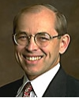
What does 2 Cor. 6:14-7:1 mean?
"
136
"The direct commands to separate from other people are always commands to separate from unbelievers, not from Christians with whom one disagrees… There are no direct New Testament commands to separate from Christians with whom one has doctrinal differences (unless those differences involve such serious heresies that the Christian faith itself is denied)."
Wayne Grudem, Systematic Theology, 877

Slide 34
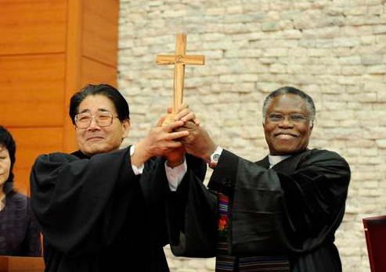
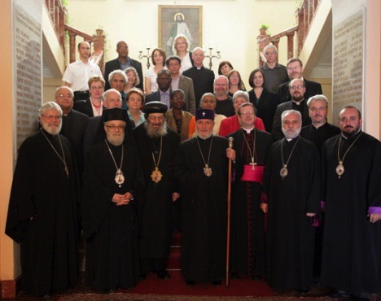
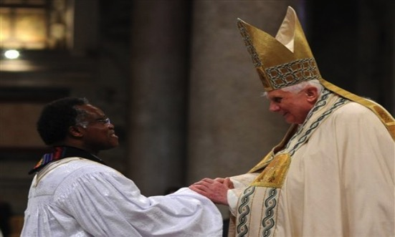
World Council of Churches
"It is better to be divided by truth than to be united by error"
Notes:
The WCC has over 250 Protestant, Catholic, Anglican, and Eastern Orthodox churches—but does it have biblical unity? No, it has organizational, external unity—but no spiritual, internal unity in the biblical sense. In fact, at the World Parliament of Religions in Chicago in 1993 the WCC encouraged its member denominations to open its arms to African shamans, Hindus, Muslims, Buddhists, and witch doctors!
• Another leader correctly noted, "It is better to be divided by truth than to be united by error."

Slide 35
Unity
Three reasons for unity
Notes:
Christ's prayer up to this point highlighted two reasons He considered unity vital…

Slide 36
I. Unity grows the church (20-23).
Unity

Slide 37
II. We'll be united in heaven forever —so let's start agreeing now (24).
Notes:
We'll be in glory together—so let's show some of that glory now.

Slide 38
III. Unity shows love that attracts unbelievers (25-26).
Notes:
United Christians draw others into the family through their love.

Slide 39
"Righteous Father, though the world does not know you, I know you, and they know that you have sent me. ²⁶I have made you known to them, and will continue to make you known in order that the love you have for me may be in them and that I myself may be in them" (17:25-26 NIV).

Slide 40
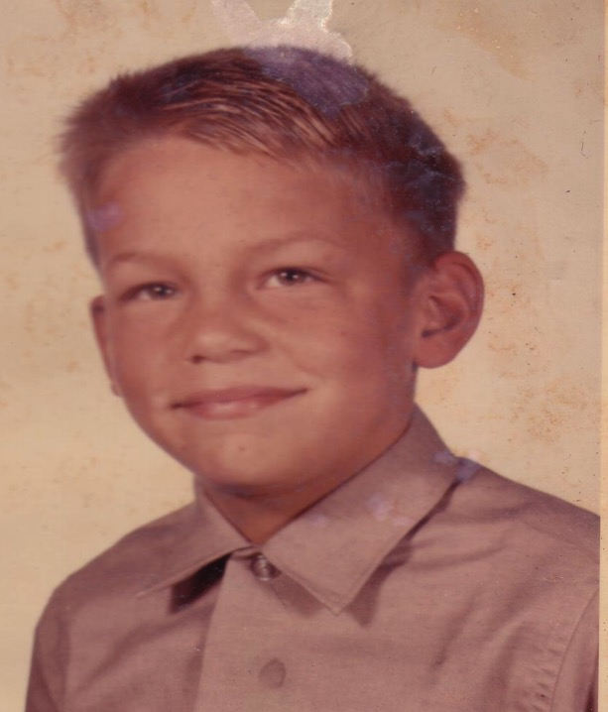
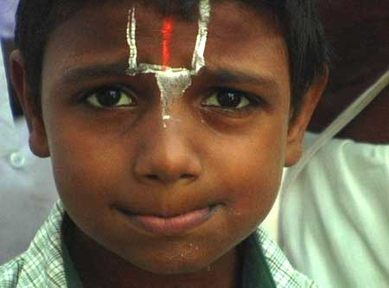
Two Boys
Notes:
A young boy grew up in a family where his mother prayed regularly to various gods, attended the festivals, went to the temple regularly. However, his father was more philosophical. Once the boy asked his father who God was, and his dad took him outside, pointed to the sky and said, "There—that's god. And beyond that is god too!" The mother's ritualistic beliefs and father's philosophical musings caused many arguments between them—so much so that the boy decided to abandon their religion for Christianity because he saw love among believers. Lack of unity ruins one's testimony!
Another young boy grew up in a "free thinker" family. His mother and father divorced when he was four, his mother remarried, and his step father and mother fought continually. They too divorced, and a third marriage began that was equally traumatic. One day the boy visited a school friend's house. The difference was amazing! No one threw things, the parents didn't argue, the father was a spiritual leader in the home, they all prayed together, there was a genuine peace and unity which made this boy want to visit that home time and again. He did. He ended up going to church with the family and soon accepted Christ. He even became a missionary for 28 years. And he's speaking to you right now.
• I have seen what Christian unity can do in my own life. I've also seen the devastating effects of disunity over the simplest issue.

Slide 41
Unity
Why is unity important?
Notes:
So why is unity so important that Christ would make it His final prayer for the saints?

Slide 42
Main Idea
Christian unity is evangelistic!
James
Thaddeus
John
Peter
Andrew
Bartholomew
James bar Alphaeus
Thomas
Simon the Zealot
Philip
Matthew
Notes:
Here is the key idea of what Jesus said: Christian unity is evangelistic (MI). When believers stick together, non-believers want to stick with them. Jesus said people that will come to Christ when they see that believers can get along.

Slide 43
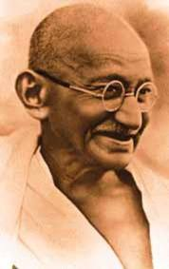
Mahatma Gandhi (1869-1948)
"I would become a Christian
—if it weren't for Christians."
Notes:
Unbelievers are also repulsed by disunity. Mahatma Gandhi was tremendously drawn to Jesus Christ and His teachings, but after seeing how Christians treated each other he said,
• "I would become a Christian
• —if it weren't for Christians."

Slide 44
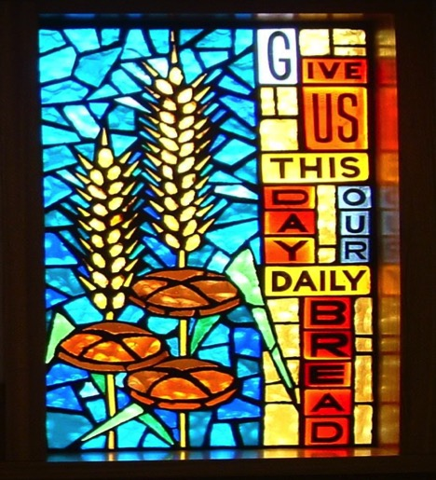
"In essentials, unity; In non-essentials, liberty; In all things, charity."
––Philip Melanchthon
Notes:
The great reformer, Philip Melanchthon, put it this way…

Slide 45
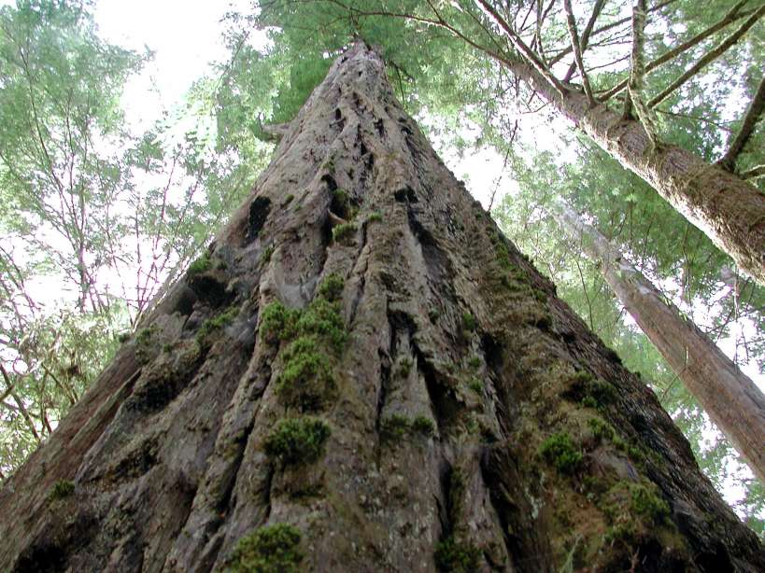
The Great Redwood Sequoias
Notes:
I grew up in Northern California with great redwood sequoia forests, the largest trees in the world. One scholar notes of them, "Redwoods are noted for age, beauty, and fine wood.

Slide 46
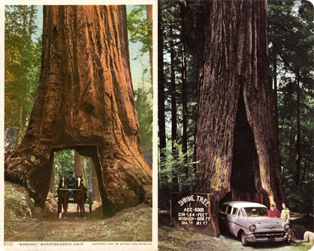
The Great Redwood Sequoias
Notes:
But one unusual characteristic of the redwoods is their tendency toward unity. Two redwoods may grow up together several feet apart, and then after 50 or 100 years the trees begin to touch.

Slide 47
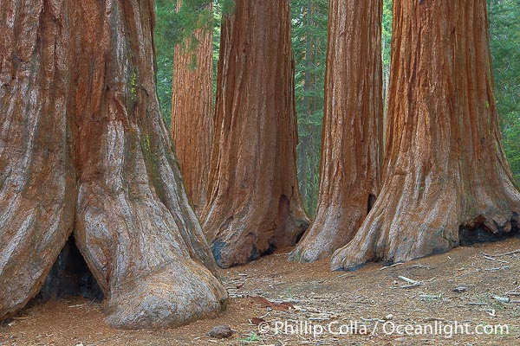
The Great Redwood Sequoias
Notes:
Quite often the bark begins to overlap and fill out so that the two trees ultimately become one!

Slide 48
The Great Redwood Sequoias
Notes:
There are cases where a dozen trees have sprung up from the outer roots of a tree that has fallen and have formed a perfect circle. After several centuries these trees have grown together so that outwardly they appear as a single giant tree!"
"In keeping with Christ's prayer, the goal of the body of Christ should be to grow into such a unity that the world will recognize us as one. The display of such unity in our individualistic society will be a testimony to the world of the divine Person and work of Christ."
J. Carl Laney, Marching Orders, 156, emphasis his

Slide 49
Black
Notes:
Can we bow together and take some time for reflection and prayer?
Do non-Christians hear you share about conflicts between believers? How have they responded? Are you surprised?
Are you a team player with all other believers—or at odds with someone? Are you willing to deal with this so Satan cannot use it for his advantage?
Does Jesus' death for all people really unite you with other believers? Do you bring people together or divide them?
Prayer

Slide 50
NT Preaching link at BibleStudyDownloads.org
Get this presentation and script for free!
Notes:
NT Preaching (np)

